Slide 1
The WAVE Regulatory Complex Links Diverse Receptors to the Actin Cytoskeleton
11510390 谭耶真
11510511 莫悦剑

Slide 2
Outline
Introduction
Methods and Results
Discussion
Reference

Slide 3
Introduction
The WASP family verprolin homologous protein(WAVE)
Celluar Processes: Adhesion, migration, division, and fusion
In animals: embryogenesis, nuron morphogenesis and plasticity, immune cell activaton and chemotaxis, cancer invasion and metastasis
WAVE is regulated by WAVE regulatory complex (WRC)
Sra1/Cyfip1
Nap1/Hem2/Kette
Abi2
HSPC300/Brick1
WAVE1/SCAR
Different WRC isoforms can be assembled from combinations of different orthologs of each component.
With the WRC, the activity of WAVE toward the Arp2/3 complex is inhibited by intracomplex sequenstration
But PCDH10 and PCDH19 do not belong to the four class
Wonder whether they might represent a new calss
Biochemimical studies of the PCDH10/WRC interaction
A conserved peptide motif, the WRC interacting receptor sequence(WIRS)

Slide 4
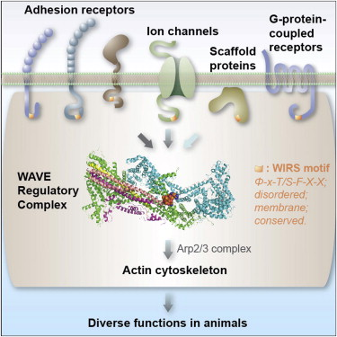

Slide 5
Methods and Results

Slide 6
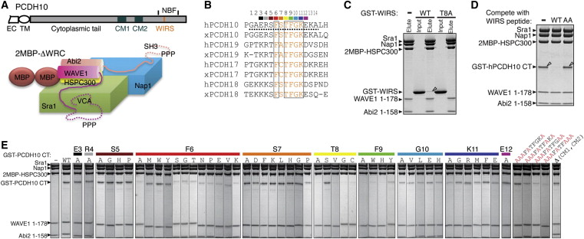
WRC Binds to a Motif in PCDH10
Whether the interation was direct
ITC---Yes
Which sequence(s) were responsible
Point Mutations---WIRS

Slide 7
Reveals Binding Mechanism from Crystal Structure
Where WIRS motif binds to the WRC?
How WIRS motif binds to the WRC?

Slide 8
Many Membrane Proteins Contain a WIRS in Their Cytoplasmic Regions
search the Swiss-Prot database to find other human proteins.
Criterion 1: search for proteins resembling PCDH10—membrane or membrane-associated proteins.
Criterion 2: remove ligands whose WIRS motifs were found in less than four of the seven species: human, mouse, chicken, frog, zebrafish, Drosophila, and C. elegans.
To avoid false positives.
Result:
Obtained 115 potential WIRS-containing WRC ligands.
Analyze: Most of these are cell-cell adhesion proteins or receptors, but some are ion channels or scaffolding proteins.

Slide 9
Many Membrane Proteins Contain a WIRS in Their Cytoplasmic Regions
Verify:
Choose 18 of these potential ligands and examined their interactions with the WRC using pull-down assays.
Disrupting the WIRS binding surface did not affect WRC binding to Rac1, suggesting that the point mutations
only locally disrupted the WIRS-binding site.

Slide 10
WIRS-Containing Tails Have Various Effects on WRC Activity
Minimal activation on its own: neither the WIRS peptide nor the PCDH10 CT increased activity of the WRC toward the Arp2/3 complex.
Cooperation with Rac1: in the presence of subsaturating concentrations of Rac1, PCDH10 CT enhanced the ability of Rac1 to stimulate WRC activity.
WIRS motif only mediates binding: the minimal WIRS peptide had no effect on Rac1 stimulation, indicating that flanking sequences in the PCDH10 CT are needed for this activity.

Slide 11
WIRS-Containing Tails Have Various Effects on WRC Activity
The activity of WIRS ligands is variable

Slide 12
WIRS Ligands Bind the WRC In Vivo
The activity of WIRS ligands is variable

Slide 13
Discussion
XXX

Slide 14
Highlights Summary
Highlights
•
Many potential WRC ligands defined by a peptide motif (WIRS) were identified
•
Motif binds to a conserved WRC surface formed by Sra and Abi subunits
•
WIRS/WRC interaction regulates oogenesis in flies

Slide 15
references
XXX

Slide 16
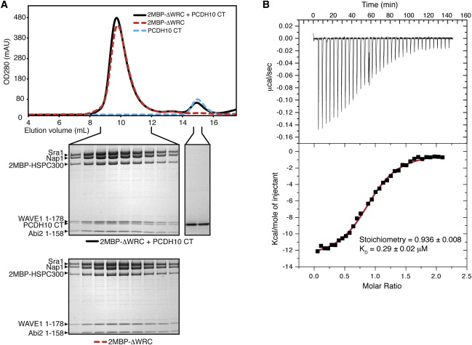
Appendix 1 PCDH10 Cytoplasmic Tail Directly Interacts with the WRC

